Slide 1
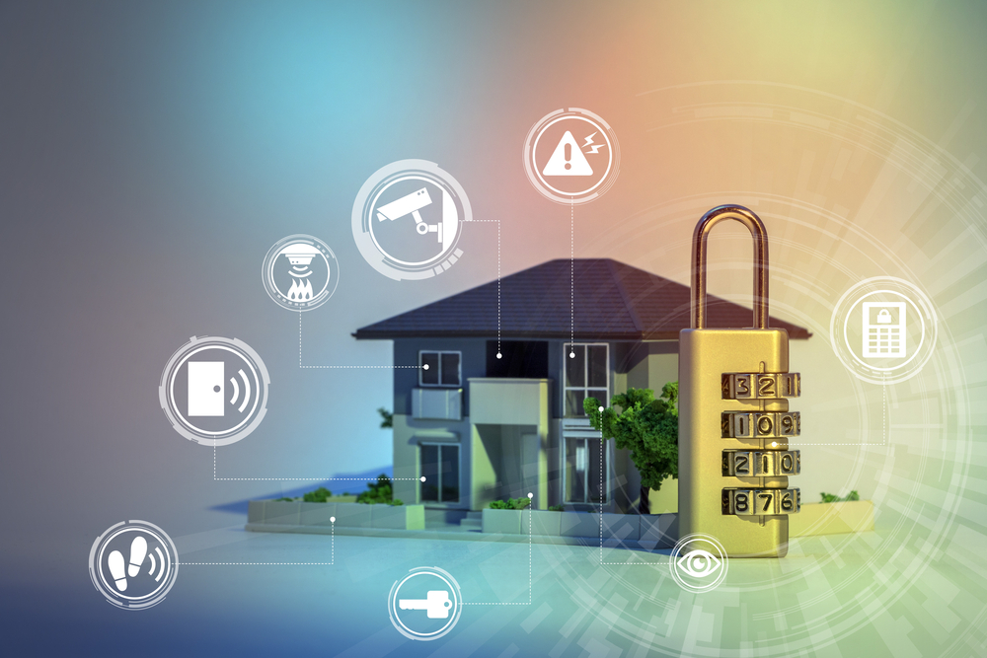
Home Safety Monitoring
Bharath Kumar Pulindram Sai Navya Gundeboyina Yasaswini Allaparthi
Hari Kiran Reddy Muthyala Bhavana Ravi Chandran
Padmanabha Reddy Kottam Vasanthi Reddy Gadireddy

Slide 2
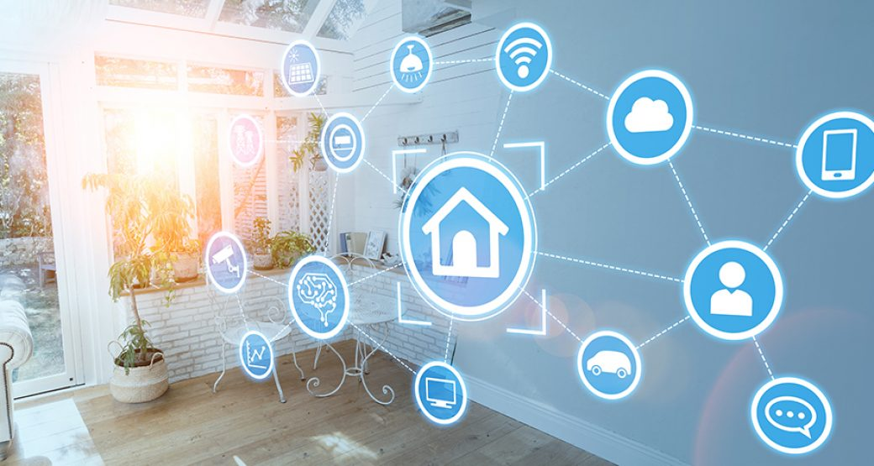
Project Description
Ensuring home safety by monitoring temperature, humidity, air quality, gas leaks, number of house-hold count.
Monitoring is done by using ESP32 and collecting all the metrics captured by the respective sensors and visualizing them in a cloud dashboard.
Alarms can be configured in the event of metrics crossing the desired limit (un-safe environment).

Slide 3
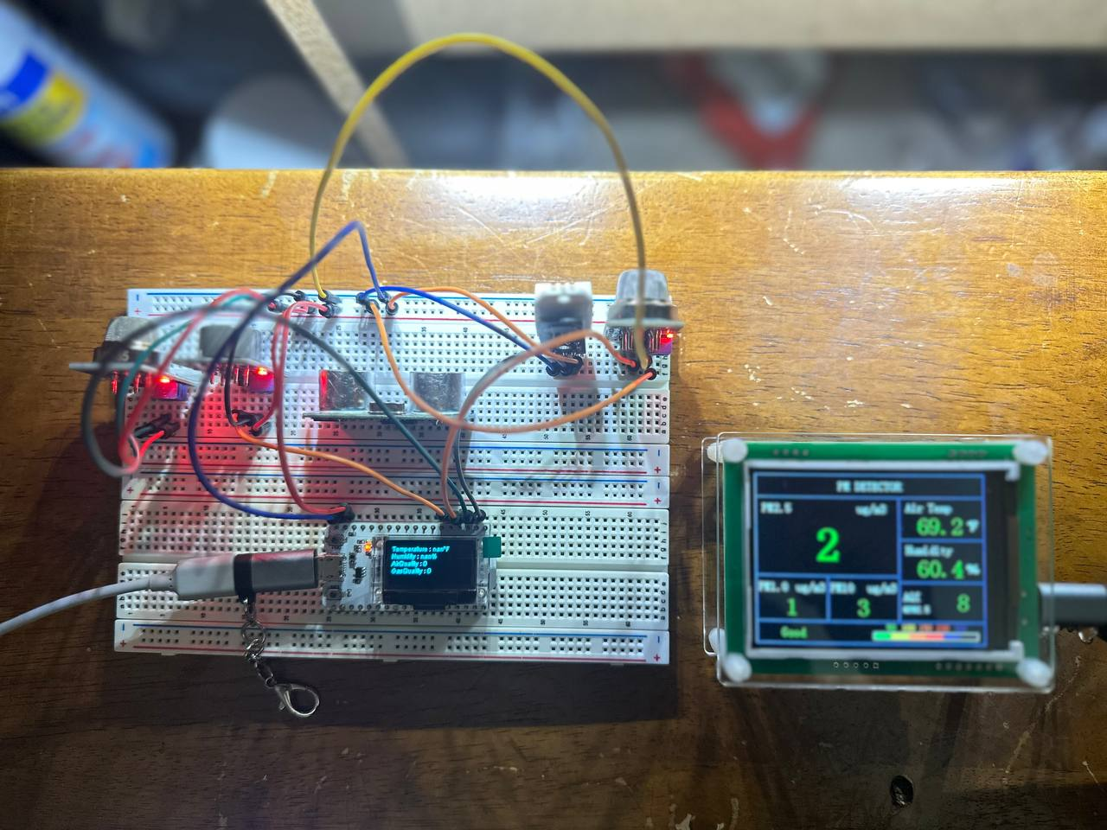
Components
Hardware
Software
ESP32 (Microcontroller)
DHT22 (Temperature and Humidity Sensor)
MQ135 (Air Quality Sensor)
MQ2 (Gas Sensor)
MQ7 (Carbon Mono-oxide sensor)
PM2.5
IR Sensor
Bread board and Jumper wires
Arduino IDE
Blynk Cloud
Circuit.io

Slide 4
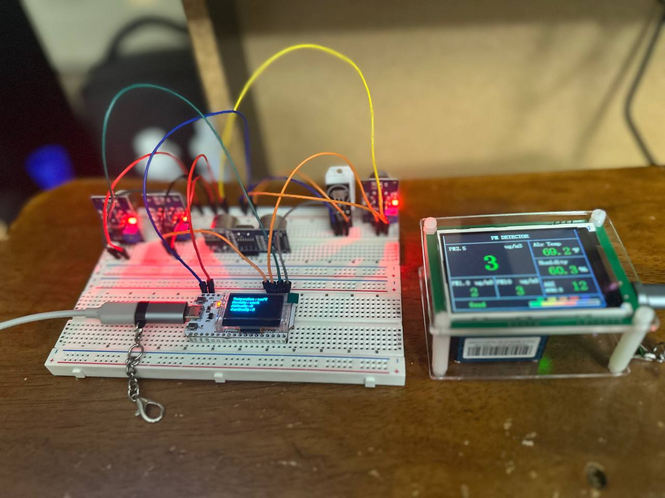
Source Code
Collect Sensor Data
Analyze and Display the Data
Code starts with defining the sensors and the outputs which they write the data to.
WiFi credentials are configured.
Blynk auth token and virtual ports are configured.
Metrics collected by sensors are written to serial console as well as on the display of ESP32.
Algorithm is designed to throw an alert (indicate via LED) when the metrics cross the safety levels.
Data collected by the sensors is sent to blynk cloud using the virtual pins and auth tokens.
Metrics are visualized in real-time based on the given time frame.
Alert is given to the household in case of concerning safety levels.
The data is also visualized on PM2.5 sensor and used for further analysis.

Slide 5
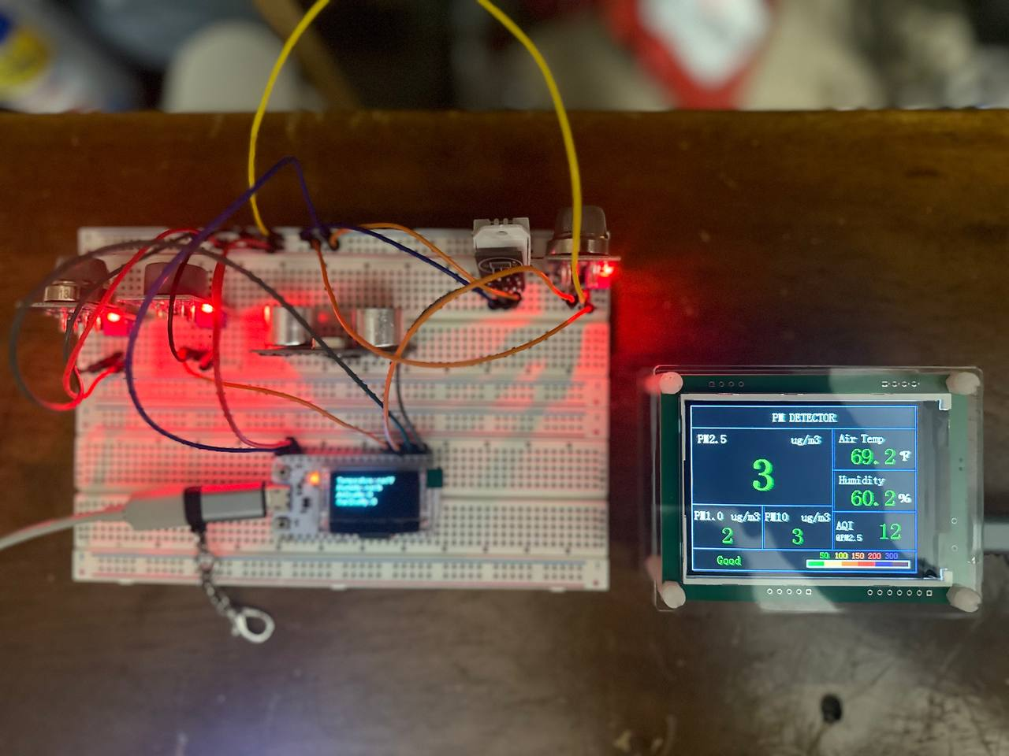
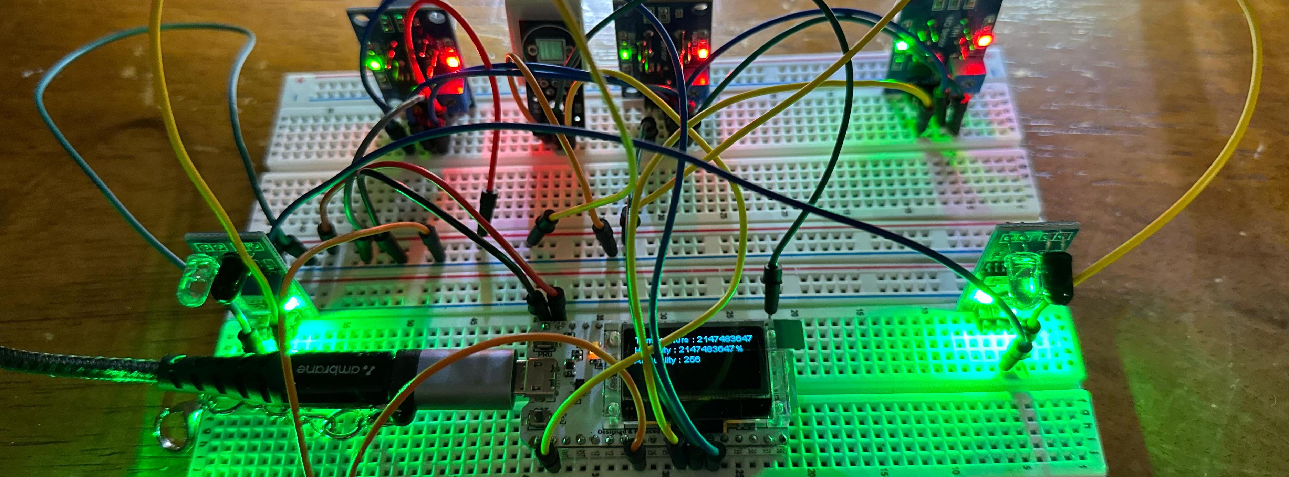
Project Setup

Slide 6
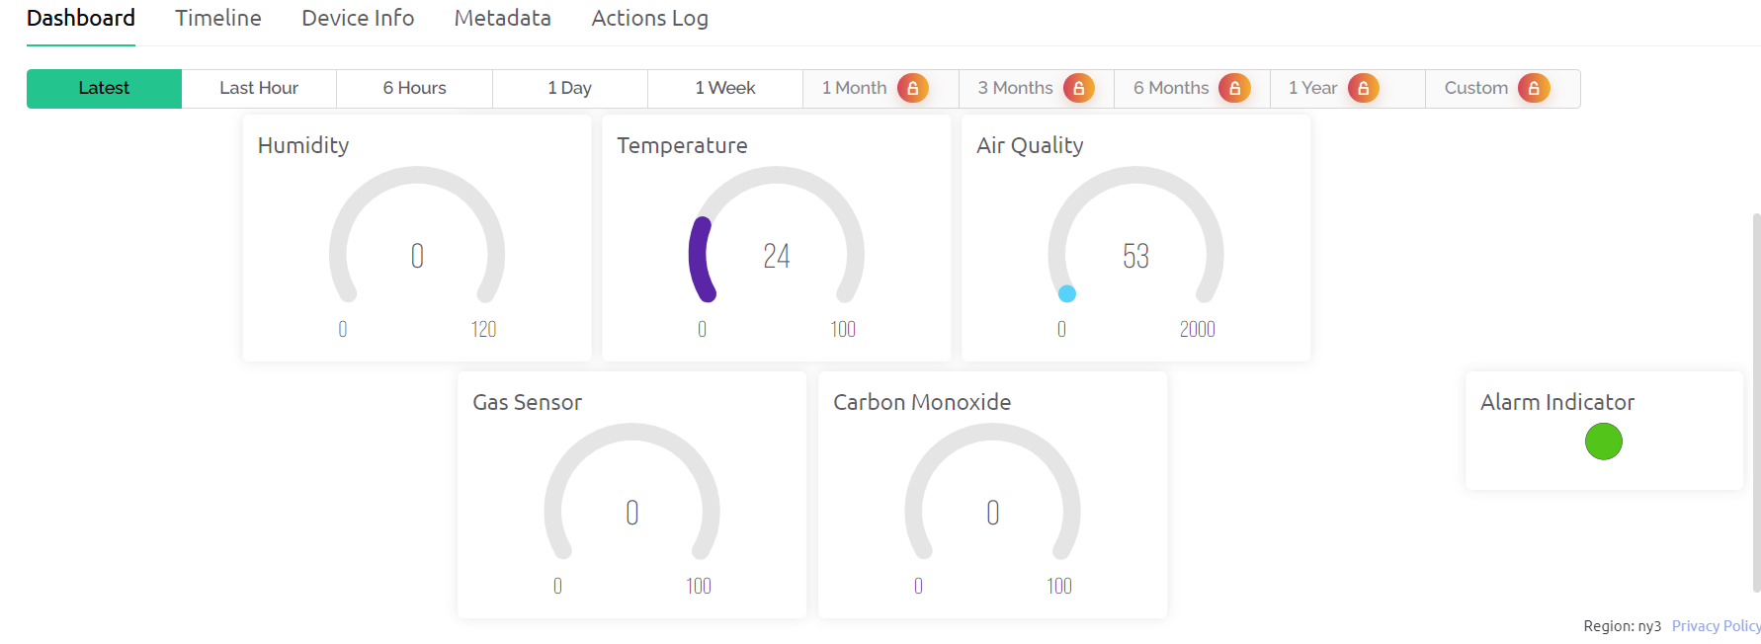
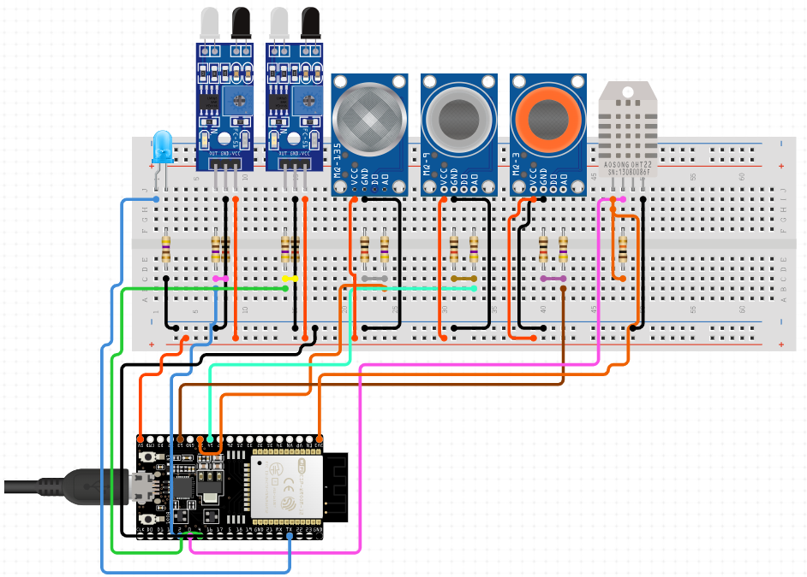
Circuit Diagram

Slide 7
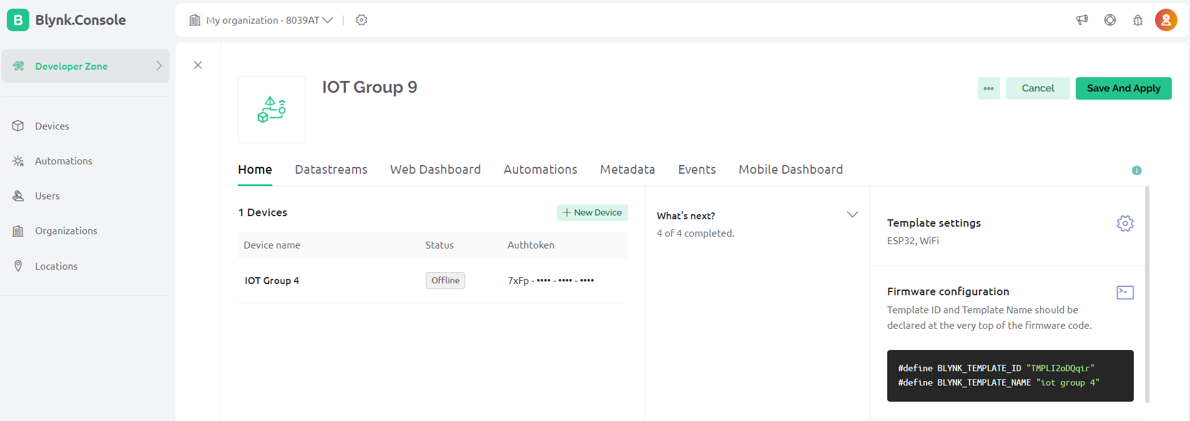
Blynk IOT Platform
Blynk platform is used to fully automate and monitor the sensor data over the cloud.
ESP32 connects and shares data to Blynk cloud via API tokens and unique project template IDs. Data from the sensors is read via virtual pins from the dashboard.

Slide 8
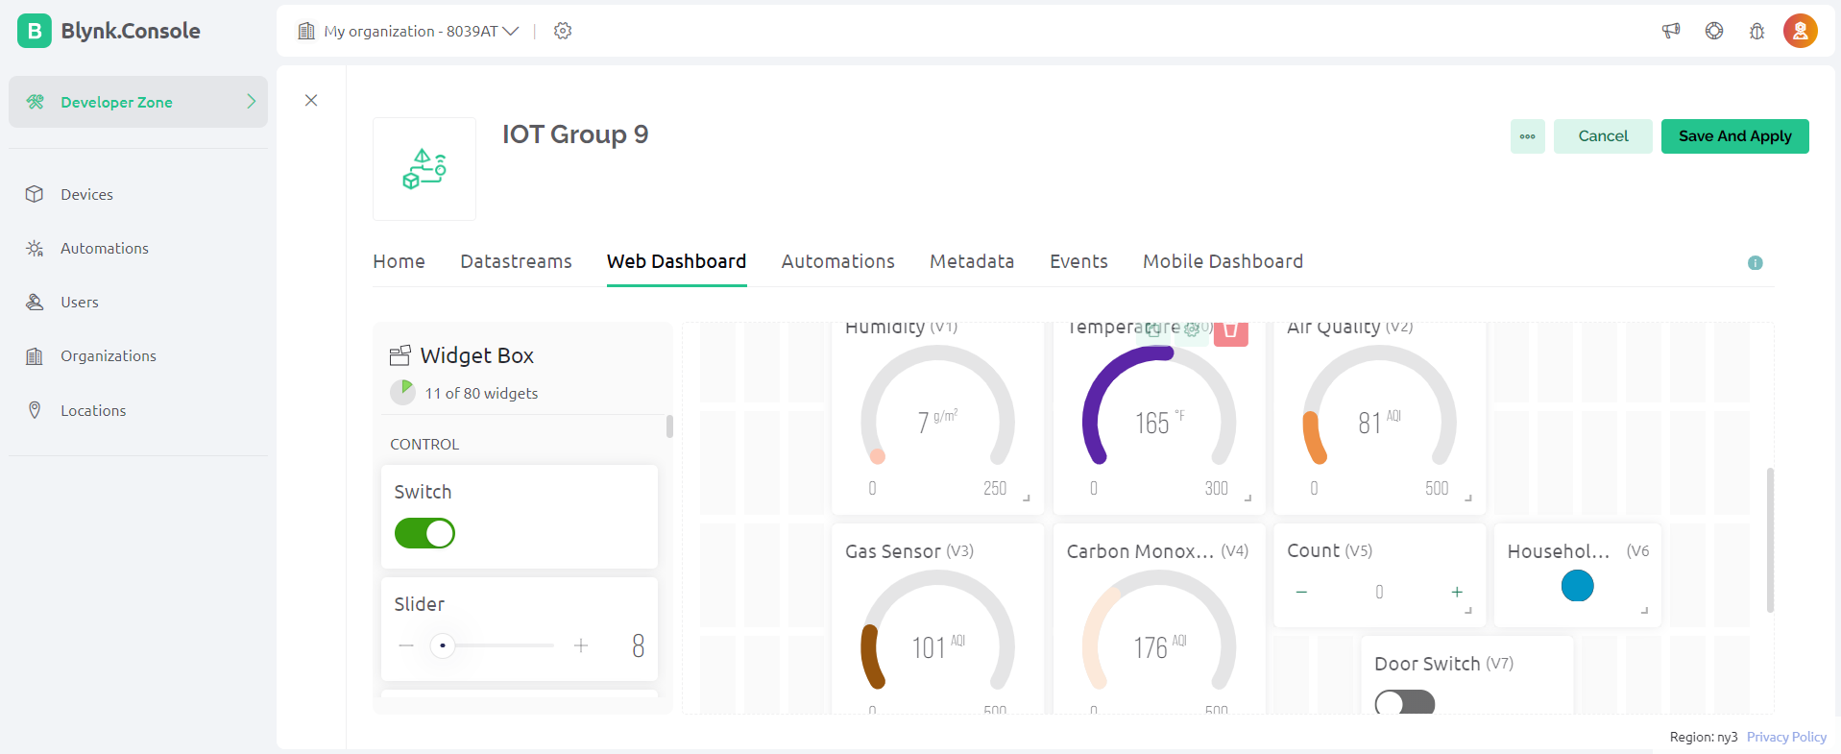
Web Dashboard
Widgets are added to record the temperature, humidity and Air quality indexes.
Visual representations are made based on the sensor data.
Heat Maps will be generated.
Counter of persons, door lock switch are also configured, and work based on the count logic.

Slide 9

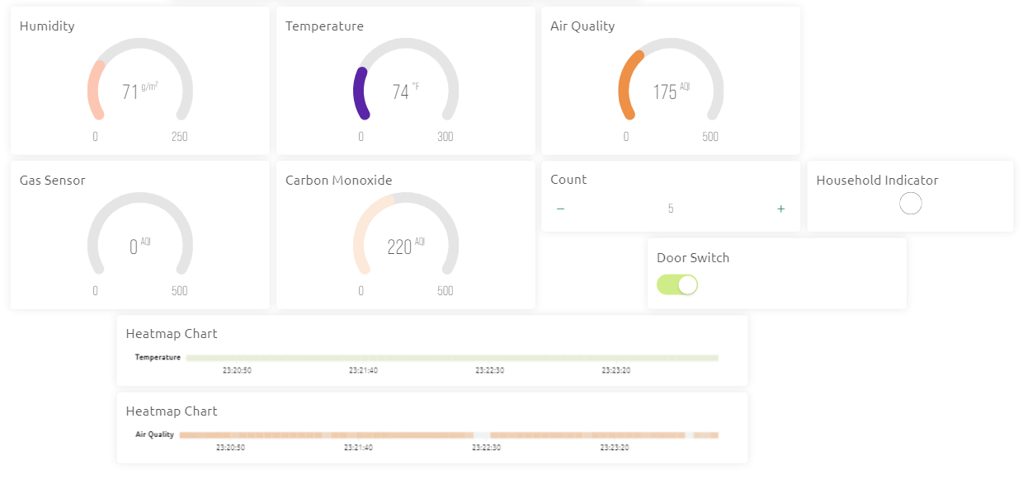
Monitoring with Blynk Dashboard

Slide 10
Results
Temperature and Quality metrics
Reference Values
Room temperature is visible via Temperature Guage
Humidity is visible via Humidity Guage
Air Quality and Gas Quality metrics are visible and can be compared with the reference values for judgements.
Heatmaps are also generated to give insights on the temperature and air quality patterns, which will help is correct air conditioning, based on time and people.
MQ 135
0-50 – Good
51-100 – Moderate
101-150 – Unhealthy for sensitive groups
151-200 – Unhealthy
MQ 7
20 – 2000ppm

Slide 11
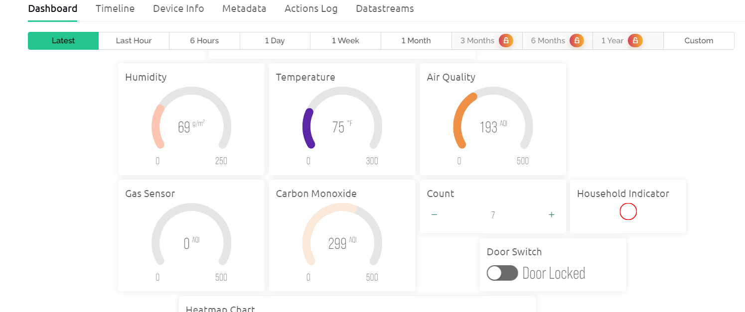
Results
House-Hold Counter
House-hold counter is visible within the dashboard.
The counter is set for a maximum value of 6.
Upon reaching the threshold, the LED turns red and the door lock slider switches off.
Indicating a clear

Slide 12
References
Blynk Dashboard: https://blynk.cloud/dashboard
Circuit Design: https://www.circuito.io/
https://learn.sparkfun.com/tutorials/esp32-lora-1-ch-gateway-lorawan-and-the-things-network/all
https://components101.com/sensors/mq135-gas-sensor-for-air-quality
https://www.sparkfun.com/datasheets/Sensors/Biometric/MQ-7.pdf
https://wiki.seeedstudio.com/Grove-Gas_Sensor-MQ5/
https://learn.adafruit.com/dht/overview
https://techatronic.com/object-counter-using-ir-sensor-and-arduino/

Slide 13
Links
Source Code: https://github.com/BharathPulindram/IOT-Final-Project
YouTube: https://youtu.be/VRSLoZ9IrOQ
Blynk Dashboard: https://blynk.cloud/dashboard/100154/global/devices/974032/organization/100154/devices/380831/dashboard

Slide 14
THANK YOU!
IOT GROUP 9

